Slide 1

Keras
Keras for Deep Learning Research

Slide 2
Overview
Convolutional Neural Networks (CNN)
Hyperparameters of CNN
Image classification with CNN

Slide 3
Convolutional Neural Network (CNN)

Slide 4
Convolutional Neural Network (CNN)
Just like the simple perceptron, CNNs also have their origins in biological research.
Hubel and Wiesel studied the structure of the visual cortex in mammals, winning a Nobel Prize in 1981.
Source: https://en.wikipedia.org/wiki/Convolutional_neural_network

Slide 5
Convolutional Neural Network (CNN)
Their research revealed that neurons in the visual cortex had a small local receptive field.
Source: https://en.wikipedia.org/wiki/Convolutional_neural_network

Slide 6

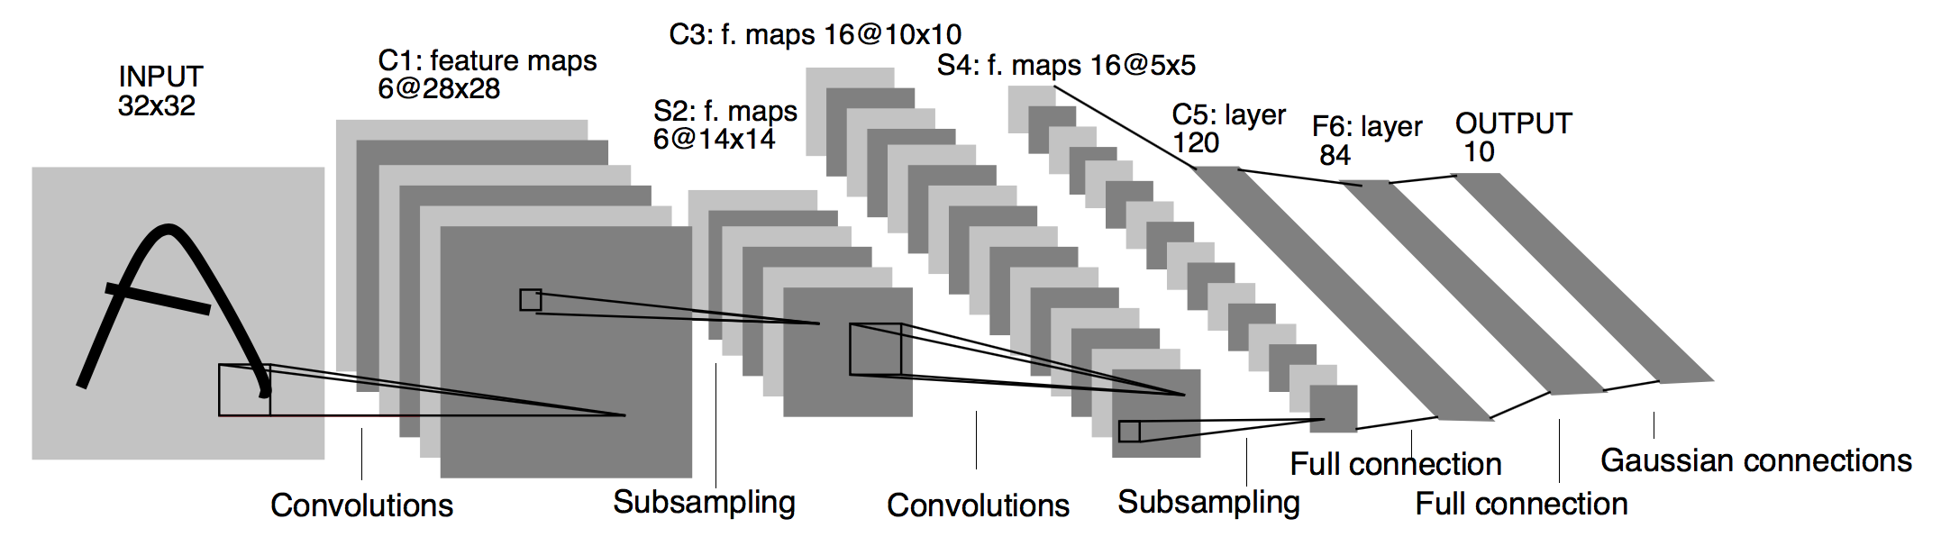
Convolutional Neural Network (CNN)
This idea then inspired an ANN architecture that would become CNN
Famously implemented in the 1998 paper by Yann LeCun et al.
The LeNet-5 architecture was first used to classify the MNIST data set.
http://yann.lecun.com/exdb/lenet/
https://en.wikipedia.org/wiki/Convolutional_neural_network
http://yann.lecun.com/exdb/lenet/

Slide 7
Convolutional Neural Network (CNN)
There are four main operations in the CNN
Convolutions and Filters
Pooling or Sub Sampling
Non-Linearity
Classification (Fully Connected Layer)
Source: https://ujjwalkarn.me/2016/08/11/intuitive-explanation-convnets/

Slide 8

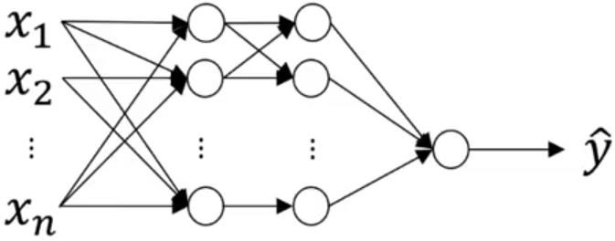
Traditional Neural Network vs. Convolutional Neural Network
32 x 32 x 3 = 3072
1000
32
_{W}12
1000 x 3072
dimensional matrix
32

Slide 9
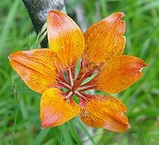
Traditional Neural Network vs. Convolutional Neural Network
1000 x 1000 x 3 = 3,000,000
1000
1000
_{W}12
1000 x 3,000,000
dimensional matrix!!!
= 3,000,000,000 features
1000

Slide 10
Traditional Neural Network vs. Convolutional Neural Network
Salient points:
Spatial relation between features in image is not considered in NN.
NN is not feasible for large images!
CNNs expect and preserve the spatial relation between features (pixels).
Learned features can be used across the whole image.
In order to perform Computer Vision operations on large images, convolution operation plays an important role.
Thus, CNNs are fundamentally important.

Slide 11
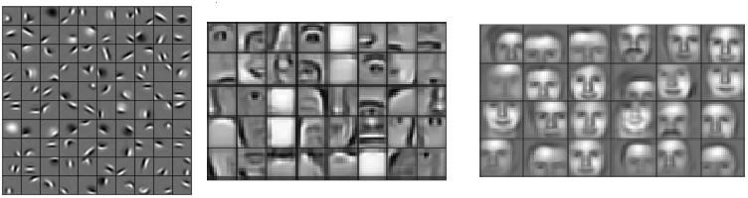
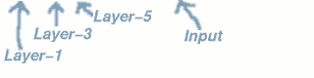
Stages of feature extraction by CNN
Low level features
Mid level features
High level features
Edges, curves and colour
Parts of objects
Complete objects

Slide 12
A toy ConvNet: X’s and O’s
Says whether a picture is of an X or an O
A two-dimensional
array of pixels
CNN
X or O

Slide 13
For example
CNN
X
CNN
O

Slide 14
Trickier cases
CNN
X
translation
scaling
rotation
weight
CNN
O

Slide 15
Deciding is hard
?
=

Slide 16
What computers see
?
=

Slide 17
What computers see

Slide 18
Computers are literal
=
x

Slide 19
ConvNets match pieces of the image
=
=
=

Slide 20
Features match pieces of the image

Slide 26
Filtering: The math behind the match

Slide 27
Foundation of Convolutional Neural Networks
Vertical Edge Detection
Input image
3 | 0 | 1 | 2 | 7 | 4
1 | 5 | 8 | 9 | 3 | 1
2 | 7 | 2 | 5 | 1 | 3
0 | 1 | 3 | 1 | 7 | 8
4 | 2 | 1 | 6 | 2 | 8
2 | 4 | 5 | 2 | 3 | 9
“Filter”, “kernel”, “feature detector”
-1 | 0 | 1
-1 | 0 | 1
-1 | 0 | 1
*
=
“Feature Map”
“Convolved Feature”
“Activation Map”
Each element in resulting matrix: sum(element-wise multiplication of filter and input image).
https://ujjwalkarn.me/2016/08/11/intuitive-explanation-convnets/

Slide 28
Foundation of Convolutional Neural Networks
Vertical Edge Detection
Input image
3 | -1 | 0 | 0 | 1 | 1 | 2 | 7 | 4
1 | -1 | 5 | 0 | 8 | 1 | 9 | 3 | 1
2 | -1 | 7 | 0 | 2 | 1 | 5 | 1 | 3
0 |  | 1 |  | 3 |  | 1 | 7 | 8
4 |  | 2 |  | 1 |  | 6 | 2 | 8
2 |  | 4 |  | 5 |  | 2 | 3 | 9
“Filter”, “kernel”, “feature detector”
5
-1 | 0 | 1
-1 | 0 | 1
-1 | 0 | 1
*
=
“Feature Map”
“Convolved Feature”
“Activation Map”

Slide 29
Foundation of Convolutional Neural Networks
Vertical Edge Detection
Input image
3 | 0 | -1 | 1 | 0 | 2 | 1 | 7 | 4
1 | 5 | -1 | 8 | 0 | 9 | 1 | 3 | 1
2 | 7 | -1 | 2 | 0 | 5 | 1 | 1 | 3
0 | 1 |  | 3 |  | 1 |  | 7 | 8
4 | 2 |  | 1 |  | 6 |  | 2 | 8
2 | 4 |  | 5 |  | 2 |  | 3 | 9
“Filter”, “kernel”, “feature detector”
5 | 4
-1 | 0 | 1
-1 | 0 | 1
-1 | 0 | 1
*
=
“Feature Map”
“Convolved Feature”
“Activation Map”

Slide 30
Foundation of Convolutional Neural Networks
Vertical Edge Detection
Input image
3 | 0 | 1 | -1 | 2 | 0 | 7 | 1 | 4
1 | 5 | 8 | -1 | 9 | 0 | 3 | 1 | 1
2 | 7 | 2 | -1 | 5 | 0 | 1 | 1 | 3
0 | 1 | 3 |  | 1 |  | 7 |  | 8
4 | 2 | 1 |  | 6 |  | 2 |  | 8
2 | 4 | 5 |  | 2 |  | 3 |  | 9
“Filter”, “kernel”, “feature detector”
5 | 4 | 0
-1 | 0 | 1
-1 | 0 | 1
-1 | 0 | 1
*
=
“Feature Map”
“Convolved Feature”
“Activation Map”

Slide 31
Foundation of Convolutional Neural Networks
Vertical Edge Detection
Input image
3 | 0 | 1 | 2 | -1 | 7 | 0 | 4 | 1
1 | 5 | 8 | 9 | -1 | 3 | 0 | 1 | 1
2 | 7 | 2 | 5 | -1 | 1 | 0 | 3 | 1
0 | 1 | 3 | 1 |  | 7 |  | 8
4 | 2 | 1 | 6 |  | 2 |  | 8
2 | 4 | 5 | 2 |  | 3 |  | 9
“Filter”, “kernel”, “feature detector”
5 | 4 | 0 | -8
-1 | 0 | 1
-1 | 0 | 1
-1 | 0 | 1
*
=
“Feature Map”
“Convolved Feature”
“Activation Map”

Slide 32
Foundation of Convolutional Neural Networks
Vertical Edge Detection
Input image
3 | 0 | 1 | 2 | 7 | 4
-1 1 | 0 5 | 1 8 | 9 | 3 | 1
₂ -1 | ₇ 0 | ₂ 1 | 5 | 1 | 3
₀ -1 | ₁ 0 | ₃ 1 | 1 | 7 | 8
4 | 2 | 1 | 6 | 2 | 8
2 | 4 | 5 | 2 | 3 | 9
“Filter”, “kernel”, “feature detector”
5 | 4 | 0 | -8
10
-1 | 0 | 1
-1 | 0 | 1
-1 | 0 | 1
*
=
“Feature Map”
“Convolved Feature”
“Activation Map”

Slide 33
Foundation of Convolutional Neural Networks
Vertical Edge Detection
Input image
3 | 0 | 1 | 2 | 7 | 4
1 | -1 5 | 0 8 | 1 9 | 3 | 1
2 | ₇ -1 | ₂ 0 | ₅ 1 | 1 | 3
0 | ₁ -1 | ₃ 0 | ₁ 1 | 7 | 8
4 | 2 | 1 | 6 | 2 | 8
2 | 4 | 5 | 2 | 3 | 9
“Filter”, “kernel”, “feature detector”
5 | 4 | 0 | -8
10 | 2
-1 | 0 | 1
-1 | 0 | 1
-1 | 0 | 1
*
=
“Feature Map”
“Convolved Feature”
“Activation Map”

Slide 34
Foundation of Convolutional Neural Networks
Vertical Edge Detection
Input image
3 | 0 | 1 | 2 | 7 | 4
1 | 5 | -1 8 | 0 9 | 1 3 | 1
2 | 7 | ₂ -1 | ₅ 0 | ₁ 1 | 3
0 | 1 | ₃ -1 | ₁ 0 | ₇ 1 | 8
4 | 2 | 1 | 6 | 2 | 8
2 | 4 | 5 | 2 | 3 | 9
“Filter”, “kernel”, “feature detector”
5 | 4 | 0 | -8
10 | 2 | 2
-1 | 0 | 1
-1 | 0 | 1
-1 | 0 | 1
*
=
“Feature Map”
“Convolved Feature”
“Activation Map”

Slide 35
Foundation of Convolutional Neural Networks
Vertical Edge Detection
Input image
3 | 0 | 1 | 2 | 7 | 4
1 | 5 | 8 | -1 9 | 0 3 | 1 1
2 | 7 | 2 | ₅ -1 | ₁ 0 | ₃ 1
0 | 1 | 3 | ₁ -1 | ₇ 0 | ₈ 1
4 | 2 | 1 | 6 | 2 | 8
2 | 4 | 5 | 2 | 3 | 9
“Filter”, “kernel”, “feature detector”
5 | 4 | 0 | -8
10 | 2 | 2 | -3
-1 | 0 | 1
-1 | 0 | 1
-1 | 0 | 1
*
=
“Feature Map”
“Convolved Feature”
“Activation Map”

Slide 36
Foundation of Convolutional Neural Networks
Vertical Edge Detection
Input image
3 | 0 | 1 | 2 | 7 | 4
1 | 5 | 8 | 9 | 3 | 1
₂ -1 | ₇ 0 | ₂ 1 | 5 | 1 | 3
₀ -1 | ₁ 0 | ₃ 1 | 1 | 7 | 8
₄ -1 | ₂ 0 | ₁ 1 | 6 | 2 | 8
2 | 4 | 5 | 2 | 3 | 9
“Filter”, “kernel”, “feature detector”
5 | 4 | 0 | -8
10 | 2 | 2 | -3
0
-1 | 0 | 1
-1 | 0 | 1
-1 | 0 | 1
*
=
“Feature Map”
“Convolved Feature”
“Activation Map”

Slide 37
Foundation of Convolutional Neural Networks
Vertical Edge Detection
Input image
3 | 0 | 1 | 2 | 7 | 4
1 | 5 | 8 | 9 | 3 | 1
2 | ₇ -1 | ₂ 0 | ₅ 1 | 1 | 3
0 | ₁ -1 | ₃ 0 | ₁ 1 | 7 | 8
4 | ₂ -1 | ₁ 0 | ₆ 1 | 2 | 8
2 | 4 | 5 | 2 | 3 | 9
“Filter”, “kernel”, “feature detector”
5 | 4 | 0 | -8
10 | 2 | 2 | -3
0 | 2
-1 | 0 | 1
-1 | 0 | 1
-1 | 0 | 1
*
=
“Feature Map”
“Convolved Feature”
“Activation Map”

Slide 38
Foundation of Convolutional Neural Networks
Vertical Edge Detection
Input image
3 | 0 | 1 | 2 | 7 | 4
1 | 5 | 8 | 9 | 3 | 1
2 | 7 | ₂ -1 | ₅ 0 | ₁ 1 | 3
0 | 1 | ₃ -1 | ₁ 0 | ₇ 1 | 8
4 | 2 | ₁ -1 | ₆ 0 | ₂ 1 | 8
2 | 4 | 5 | 2 | 3 | 9
“Filter”, “kernel”, “feature detector”
5 | 4 | 0 | -8
10 | 2 | 2 | -3
0 | 2 | 4
-1 | 0 | 1
-1 | 0 | 1
-1 | 0 | 1
*
=
“Feature Map”
“Convolved Feature”
“Activation Map”

Slide 39
Foundation of Convolutional Neural Networks
Vertical Edge Detection
Input image
3 | 0 | 1 | 2 | 7 | 4
1 | 5 | 8 | 9 | 3 | 1
2 | 7 | 2 | ₅ -1 | ₁ 0 | ₃ 1
0 | 1 | 3 | ₁ -1 | ₇ 0 | ₈ 1
4 | 2 | 1 | ₆ -1 | ₂ 0 | ₈ 1
2 | 4 | 5 | 2 | 3 | 9
“Filter”, “kernel”, “feature detector”
5 | 4 | 0 | -8
10 | 2 | 2 | -3
0 | 2 | 4 | 7
-1 | 0 | 1
-1 | 0 | 1
-1 | 0 | 1
*
=
“Feature Map”
“Convolved Feature”
“Activation Map”

Slide 40
Foundation of Convolutional Neural Networks
Vertical Edge Detection
Input image
3 | 0 | 1 | 2 | 7 | 4
1 | 5 | 8 | 9 | 3 | 1
2 | 7 | 2 | 5 | 1 | 3
₀ -1 | ₁ 0 | ₃ 1 | 1 | 7 | 8
₄ -1 | ₂ 0 | ₁ 1 | 6 | 2 | 8
₂ -1 | ₄ 0 | ₅ 1 | 2 | 3 | 9
“Filter”, “kernel”, “feature detector”
5 | 4 | 0 | -8
10 | 2 | 2 | -3
0 | 2 | 4 | 7
3
-1 | 0 | 1
-1 | 0 | 1
-1 | 0 | 1
*
=
“Feature Map”
“Convolved Feature”
“Activation Map”

Slide 41
Foundation of Convolutional Neural Networks
Vertical Edge Detection
Input image
3 | 0 | 1 | 2 | 7 | 4
1 | 5 | 8 | 9 | 3 | 1
2 | 7 | 2 | 5 | 1 | 3
0 | ₁ -1 | ₃ 0 | ₁ 1 | 7 | 8
4 | ₂ -1 | ₁ 0 | ₆ 1 | 2 | 8
2 | ₄ -1 | ₅ 0 | ₂ 1 | 3 | 9
“Filter”, “kernel”, “feature detector”
5 | 4 | 0 | -8
10 | 2 | 2 | -3
0 | 2 | 4 | 7
3 | 2
-1 | 0 | 1
-1 | 0 | 1
-1 | 0 | 1
*
=
“Feature Map”
“Convolved Feature”
“Activation Map”

Slide 42
Foundation of Convolutional Neural Networks
Vertical Edge Detection
Input image
3 | 0 | 1 | 2 | 7 | 4
1 | 5 | 8 | 9 | 3 | 1
2 | 7 | 2 | 5 | 1 | 3
0 | 1 | ₃ -1 | ₁ 0 | ₇ 1 | 8
4 | 2 | ₁ -1 | ₆ 0 | ₂ 1 | 8
2 | 4 | ₅ -1 | ₂ 0 | ₃ 1 | 9
“Filter”, “kernel”, “feature detector”
5 | 4 | 0 | -8
10 | 2 | 2 | -3
0 | 2 | 4 | 7
3 | 2 | 3
-1 | 0 | 1
-1 | 0 | 1
-1 | 0 | 1
*
=
“Feature Map”
“Convolved Feature”
“Activation Map”

Slide 43
Foundation of Convolutional Neural Networks
Vertical Edge Detection
Input image
3 | 0 | 1 | 2 | 7 | 4
1 | 5 | 8 | 9 | 3 | 1
2 | 7 | 2 | 5 | 1 | 3
0 | 1 | 3 | ₁ -1 | ₇ 0 | ₈ 1
4 | 2 | 1 | ₆ -1 | ₂ 0 | ₈ 1
2 | 4 | 5 | ₂ -1 | ₃ 0 | ₉ 1
“Filter”, “kernel”, “feature detector”
5 | 4 | 0 | -8
10 | 2 | 2 | -3
0 | 2 | 4 | 7
3 | 2 | 3 | 16
-1 | 0 | 1
-1 | 0 | 1
-1 | 0 | 1
*
=
“Feature Map”
“Convolved Feature”
“Activation Map”

Slide 44
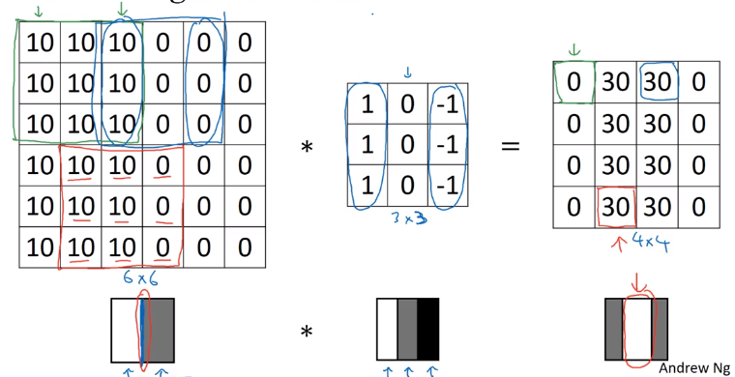
Foundation of Convolutional Neural Networks
Vertical Edge Detection
https://www.youtube.com/watch?v=XuD4C8vJzEQ

Slide 45


Foundation of Convolutional Neural Networks
https://cs.nyu.edu/~fergus/tutorials/deep_learning_cvpr12/
https://ujjwalkarn.me/2016/08/11/intuitive-explanation-convnets/

Slide 46
Foundation of Convolutional Neural Networks
The values of these filters are learned by the network during the training process.
But you need to specify these parameters:
Number of filter.
The more filters you have the more feature maps to you get to help the network.
The more parameters you add to the network.
Filter size.
https://ujjwalkarn.me/2016/08/11/intuitive-explanation-convnets/

Slide 47
Padding
While using convolving operation the size of the original image shrinks.
Also, the information in the edges of the image will not contribute that much to the learning phase
What to do?

Slide 48
Foundation of Convolutional Neural Networks
Padding
Image 6 x 6 | * Filter 3 x 3 | = | Output Image 4 x 4
𝑛 ∗ 𝑛 | 𝑓 ∗ 𝑓 |  | 𝑛_𝑜𝑢𝑡 ∗ 𝑛_𝑜𝑢𝑡 using 𝑛_𝑜𝑢𝑡 = 𝑛 − 𝑓 + 1
Shortcoming of this technique:
Output goes on shrinking as the number of layers increase.
Information from boundary of the image remains unused.
Solution is Zero padding around the edges of the image!

Slide 49

Foundation of Convolutional Neural Networks
Padding
If Image is 6 x 6
𝑛_𝑜𝑢𝑡 = 𝑛 − 𝑓 + 1
= 6 − 3 + 1
= 4
Thus, Output Image = 4 x 4
No padding, no strides
https://github.com/vdumoulin/conv_arithmetic

Slide 50

Foundation of Convolutional Neural Networks
Padding
0 | 0 | 0 | 0 | 0 | 0 | 0 | 0
0 |  |  |  |  |  |  | 0
0 |  |  |  |  |  |  | 0
0 |  |  |  |  |  |  | 0
0 |  |  |  |  |  |  | 0
0 |  |  |  |  |  |  | 0
0 |  |  |  |  |  |  | 0
0 | 0 | 0 | 0 | 0 | 0 | 0 | 0
If 𝑝 =1
𝑛𝑜𝑢𝑡 = 𝑛 + 2𝑝 − 𝑓 + 1
= 6 + (2 ∗ 1) − 3 + 1
= 6
Thus, Output Image = 6 x 6
https://github.com/vdumoulin/conv_arithmetic

Slide 51

Foundation of Convolutional Neural Networks
Padding
0 | 0 | 0 | 0 | 0 | 0 | 0 | 0 | 0 | 0
0 | 0 | 0 | 0 | 0 | 0 | 0 | 0 | 0 | 0
0 | 0 |  |  |  |  |  |  | 0 | 0
0 | 0 |  |  |  |  |  |  | 0 | 0
0 | 0 |  |  |  |  |  |  | 0 | 0
0 | 0 |  |  |  |  |  |  | 0 | 0
0 | 0 |  |  |  |  |  |  | 0 | 0
0 | 0 |  |  |  |  |  |  | 0 | 0
0 | 0 | 0 | 0 | 0 | 0 | 0 | 0 | 0 | 0
0 | 0 | 0 | 0 | 0 | 0 | 0 | 0 | 0 | 0
If 𝑝 =2
𝑛𝑜𝑢𝑡 = 𝑛 + 2𝑝 − 𝑓 + 1
= 6 + (2 ∗ 2) − 3 + 1
= 6 + 4 − 3 + 1
= 8
Thus, Output Image = 8 x 8
https://github.com/vdumoulin/conv_arithmetic

Slide 52
Foundation of Convolutional Neural Networks
Padding
How much to pad?
Valid = no padding.
Follows the formula 𝑛𝑜𝑢𝑡 = 𝑛 − 𝑓 + 1.
Same = Output dimension is Same as input. Follows the formula 𝑛𝑜𝑢𝑡 = 𝑛 + 2𝑝 − 𝑓 + 1.
To keep Output size same as input size: 𝑛 = 𝑛 + 2𝑝 − 𝑓 + 1
𝑝 =
𝑓−1
Thus, filters are generally odd.
2

Slide 53
Foundation of Convolutional Neural Networks
Strided Convolution: Shifting of filter by 𝑠 pixels during convolution. Here,𝑠 = 2.
3 | -1 | 0 | 0 | 1 | 1 | 2 | 7 | 4 | 2
1 | -1 | 5 | 0 | 8 | 1 | 9 | 3 | 1 | 1
2 | -1 | 7 | 0 | 2 | 1 | 5 | 1 | 3 | 5
0 |  | 1 |  | 3 |  | 1 | 7 | 8 | 4
4 |  | 2 |  | 1 |  | 6 | 2 | 8 | 3
2 |  | 4 |  | 5 |  | 2 | 3 | 9 | 8
2 |  | 3 |  | 6 |  | 4 | 2 | 0 | 1
5
-1 | 0 | 1
-1 | 0 | 1
-1 | 0 | 1
*
=

Slide 54
Foundation of Convolutional Neural Networks
Strided Convolution
3 | 0 | 1 | -1 | 2 | 0 | 7 | 1 | 4 | 2
1 | 5 | 8 | -1 | 9 | 0 | 3 | 1 | 1 | 1
2 | 7 | 2 | -1 | 5 | 0 | 1 | 1 | 3 | 5
0 | 1 | 3 |  | 1 |  | 7 |  | 8 | 4
4 | 2 | 1 |  | 6 |  | 2 |  | 8 | 3
2 | 4 | 5 |  | 2 |  | 3 |  | 9 | 8
2 | 3 | 6 |  | 4 |  | 2 |  | 0 | 1
5 | 0
-1 | 0 | 1
-1 | 0 | 1
-1 | 0 | 1
*
=

Slide 55
Foundation of Convolutional Neural Networks
Strided Convolution
3 | 0 | 1 | 2 | 7 | -1 | 4 | 0 | 2 | 1
1 | 5 | 8 | 9 | 3 | -1 | 1 | 0 | 1 | 1
2 | 7 | 2 | 5 | 1 | -1 | 3 | 0 | 5 | 1
0 | 1 | 3 | 1 | 7 |  | 8 |  | 4
4 | 2 | 1 | 6 | 2 |  | 8 |  | 3
2 | 4 | 5 | 2 | 3 |  | 9 |  | 8
2 | 3 | 6 | 4 | 2 |  | 0 |  | 1
5 | 0 | -3
-1 | 0 | 1
-1 | 0 | 1
-1 | 0 | 1
*
=
convention: stop moving if filter goes out of image border.

Slide 56
Foundation of Convolutional Neural Networks
Strided Convolution
3 | 0 | 1 | 2 | 7 | 4 | 2
1 | 5 | 8 | 9 | 3 | 1 | 1
-1 2 | 0 7 | 1 2 | 5 | 1 | 3 | 5
-1 0 | 0 1 | 1 3 | 1 | 7 | 8 | 4
-1 4 | 0 2 | 1 1 | 6 | 2 | 8 | 3
2 | 4 | 5 | 2 | 3 | 9 | 8
2 | 3 | 6 | 4 | 2 | 0 | 1
5 | 0 | -3
0
-1 | 0 | 1
-1 | 0 | 1
-1 | 0 | 1
*
=

Slide 57
Foundation of Convolutional Neural Networks
Strided Convolution
3 | 0 | 1 | 2 | 7 | 4 | 2
1 | 5 | 8 | 9 | 3 | 1 | 1
2 | 7 | -1 2 | 0 5 | 1 1 | 3 | 5
0 | 1 | -1 3 | 0 1 | 1 7 | 8 | 4
4 | 2 | -1 1 | 0 6 | 1 2 | 8 | 3
2 | 4 | 5 | 2 | 3 | 9 | 8
2 | 3 | 6 | 4 | 2 | 0 | 1
5 | 0 | -3
0 | 4
-1 | 0 | 1
-1 | 0 | 1
-1 | 0 | 1
*
=

Slide 58
Foundation of Convolutional Neural Networks
Strided Convolution
3 | 0 | 1 | 2 | 7 | 4 | 2
1 | 5 | 8 | 9 | 3 | 1 | 1
2 | 7 | 2 | 5 | -1 1 | 0 3 | 1 5
0 | 1 | 3 | 1 | -1 7 | 0 8 | 1 4
4 | 2 | 1 | 6 | -1 2 | 0 8 | 1 3
2 | 4 | 5 | 2 | 3 | 9 | 8
2 | 3 | 6 | 4 | 2 | 0 | 1
5 | 0 | -3
0 | 4 | 2
-1 | 0 | 1
-1 | 0 | 1
-1 | 0 | 1
*
=
convention: stop moving if filter goes out of image border.

Slide 59
Foundation of Convolutional Neural Networks
Strided Convolution
3 | 0 | 1 | 2 | 7 | 4 | 2
1 | 5 | 8 | 9 | 3 | 1 | 1
2 | 7 | 2 | 5 | 1 | 3 | 5
0 | 1 | 3 | 1 | 7 | 8 | 4
₄ -1 | ₂ 0 | ₁ 1 | 6 | 2 | 8 | 3
₂ -1 | ₄ 0 | ₅ 1 | 2 | 3 | 9 | 8
₂ -1 | ₃ 0 | ₆ 1 | 4 | 2 | 0 | 1
5 | 0 | -3
0 | 4 | 2
4
-1 | 0 | 1
-1 | 0 | 1
-1 | 0 | 1
*
=

Slide 60
Foundation of Convolutional Neural Networks
Strided Convolution
3 | 0 | 1 | 2 | 7 | 4 | 2
1 | 5 | 8 | 9 | 3 | 1 | 1
2 | 7 | 2 | 5 | 1 | 3 | 5
0 | 1 | 3 | 1 | 7 | 8 | 4
4 | 2 | ₁ -1 | ₆ 0 | ₂ 1 | 8 | 3
2 | 4 | ₅ -1 | ₂ 0 | ₃ 1 | 9 | 8
2 | 3 | ₆ -1 | ₄ 0 | ₂ 1 | 0 | 1
5 | 0 | -3
0 | 4 | 2
4 | -5
-1 | 0 | 1
-1 | 0 | 1
-1 | 0 | 1
*
=

Slide 61
Foundation of Convolutional Neural Networks
Strided Convolution
3 | 0 | 1 | 2 | 7 | 4 | 2
1 | 5 | 8 | 9 | 3 | 1 | 1
2 | 7 | 2 | 5 | 1 | 3 | 5
0 | 1 | 3 | 1 | 7 | 8 | 4
4 | 2 | 1 | 6 | ₂-1 | ₈ 0 | ₃1
2 | 4 | 5 | 2 | ₃-1 | ₉ 0 | ₈1
2 | 3 | 6 | 4 | ₂-1 | ₀ 0 | ₁1
5 | 0 | -3
0 | 4 | 2
4 | -5 | 5
-1 | 0 | 1
-1 | 0 | 1
-1 | 0 | 1
*
=
convention: stop moving if filter goes out of image border.

Slide 62
Foundation of Convolutional Neural Networks
Strided Convolution
if input image (n*n), filter size (f*f), padding = f, stride = s
output shape = (floor((n+2p-f)/s) + 1) * (floor((n+2p-f)/s) + 1)
3 | 0 | 1 | 2 | 7 | 4 | 2
1 | 5 | 8 | 9 | 3 | 1 | 1
2 | 7 | 2 | 5 | 1 | 3 | 5
0 | 1 | 3 | 1 | 7 | 8 | 4
4 | 2 | 1 | 6 | ₂-1 | ₈ 0 | ₃1
2 | 4 | 5 | 2 | ₃-1 | ₉ 0 | ₈1
2 | 3 | 6 | 4 | ₂-1 | ₀ 0 | ₁1
-1 | 0 | 1
-1 | 0 | 1
-1 | 0 | 1
5 | 0 | -3
0 | 4 | 2
4 | -5 | 5
*
=
Here, Stride(S) = 2
𝑛+2𝑝−𝑓 ₊ ₁
7+2∗0−3 ₊ ₁
Thus, 𝑛𝑜𝑢𝑡 =
=
= ⁴ + 1
𝑠
2
2
4
= ₂ + 1 = 3
If input image is 6x6 then Output Image will be ?

Slide 63
Foundation of Convolutional Neural Networks
Strided Convolution
if input image (n*n), filter size (f*f), padding = f, stride = s
output shape = (floor((n+2p-f)/s) + 1) * (floor((n+2p-f)/s) + 1)
3 | 0 | 1 | 2 | 7 | 4 | 2
1 | 5 | 8 | 9 | 3 | 1 | 1
2 | 7 | 2 | 5 | 1 | 3 | 5
0 | 1 | 3 | 1 | 7 | 8 | 4
4 | 2 | 1 | 6 | ₂-1 | ₈ 0 | ₃1
2 | 4 | 5 | 2 | ₃-1 | ₉ 0 | ₈1
2 | 3 | 6 | 4 | ₂-1 | ₀ 0 | ₁1
-1 | 0 | 1
-1 | 0 | 1
-1 | 0 | 1
5 | 0 | -3
0 | 4 | 2
4 | -5 | 5
*
=
Here, Stride(S) = 2
𝑛+2𝑝−𝑓 ₊ ₁
7+2∗0−3 ₊ ₁
Thus, 𝑛𝑜𝑢𝑡 =
=
= ⁴ + 1
𝑠
2
2
4
= ₂ + 1 = 3
If input image is 6x6 then Output Image will be still 2x2 if all other factors are constant.

Slide 64
Foundation of Convolutional Neural Networks
Summary of Convolution
For an 𝑛 ∗ 𝑛 image and filter 𝑓 ∗ 𝑓 with padding 𝑝 and a stride of 𝑠 pixels,
Output image dimension is given by:
𝑛 + 2𝑝 − 𝑓
𝑛 + 2𝑝 − 𝑓
+ 1 ∗
+ 1
𝑠
𝑠

Slide 65
Convolution on Color images
Image
Filter
Output
*
=
?
6x6x3
3x3

Slide 66
Convolution on Color images
Image
 |  |  |  |  |  |  |  |  |  |  |  |  |  |  | Filter |  |  |  |  |  | Output
 |  |  |  |  |  |  |  |  |  |  |  |  |  |  | * |  |  |  | =
 |  |  |  |  | 6x6x3 |  |  |  |  |  |  |  |  |  | 3x3x3 |  |  |  |  |  | 4x4x1

Slide 67
Convolution on Color images
Image
Filter
Output
*
=
6x6x3
3x3x3
4x4x1

Slide 68
Convolution on Color images
Image
Filter
Output
*
=
6x6x3
3x3x3
4x4x1

Slide 69
Convolution on Color images
Image
Filter
Output
*
=
6x6x3
3x3x3
4x4x1

Slide 70
Convolution on Color images
Image
Filter
Output
*
=
6x6x3
3x3x3
4x4x1

Slide 71
Convolution on Color images
Image
Filter
Output
*
=
6x6x3
3x3x3
4x4x1

Slide 72
Convolution on Color images
Image
Filter
Output
*
=
6x6x3
3x3x3
4x4x1

Slide 73
Convolution on Color images
Image
Filter
Output
*
=
6x6x3
3x3x3
4x4x1

Slide 74
Convolution on Color images
Image
Filter
Output
*
=
6x6x3
3x3x3
4x4x1

Slide 75
Convolution on Color images
Image
Filter
Output
*
=
6x6x3
3x3x3
4x4x1

Slide 76
Convolution on Color images
Image
Filter
Output
*
=
6x6x3
3x3x3
4x4x1

Slide 77
Convolution on Color images
Image
Filter
Output
*
=
6x6x3
3x3x3
4x4x1

Slide 78
Convolution on Color images
Image
Filter
Output
*
=
6x6x3
3x3x3
4x4x1

Slide 79
Convolution on Color images
Image
Filter
Output
*
=
6x6x3
3x3x3
4x4x1

Slide 80
Convolution on Color images
Image
Filter
Output
*
=
6x6x3
3x3x3
4x4x1

Slide 81
Convolution on Color images
Image
Filter
Output
*
=
6x6x3
3x3x3
4x4x1

Slide 82
Convolution on Color images
Image
Filter
Output
*
=
6x6x3
3x3x3
4x4x1

Slide 83
Convolution on Color images
Image
Filter
Output
*
=
6x6x3
3x3x3
4x4x1

Slide 84
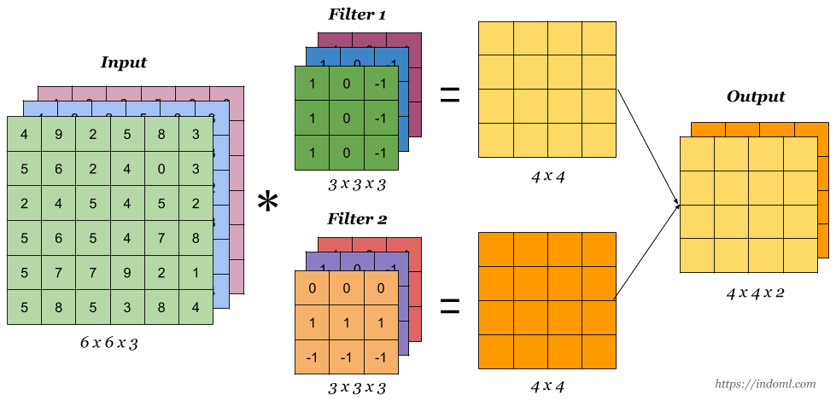
Convolution on Color images Multiple filters
https://stackoverflow.com/a/54279463

Slide 85
Pooling Layer
Purpose:
“Its function is to progressively reduce the spatial size of the representation to reduce the amount of parameters and computation in the network, and hence to also control overfitting.” Link
Useful for extracting dominant features which are rotational and positional invariant.
Types:
Max Pooling
Average Pooling

Slide 86
Pooling Layer
1 | 3 | 2 | 1
3 | 6 | 8 | 9
8 | 3 | 3 | 9
4 | 6 | 8 | 2
Max
6 | 9
8 | 9

Slide 87
Pooling Layer
1 | 3 | 2 | 1
3 | 6 | 8 | 9
8 | 3 | 3 | 9
4 | 6 | 8 | 2
3.25 | 5
5.25 | 5.5
Average
Max
6 | 9
8 | 9

Slide 88
Pooling Layer
1 | 3 | 2 | 1
3 | 6 | 8 | 9
8 | 3 | 3 | 9
4 | 6 | 8 | 2
3.25 | 5
5.25 | 5.5
Average
Max
6 | 9
8 | 9
Salient features:
Follows the process of convolution with filters of size 𝑓, stride 𝑠 (2) and padding 𝑝 (not used much) as the hyperparameters.
Filters have no weights. So, no trainable parameters.
Pooling operation is carried out channel-wise. Thus, number of channels remain unchanged.

Slide 89
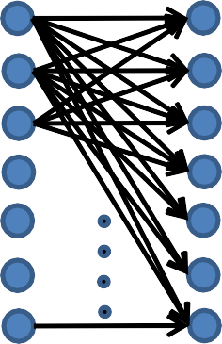
Why Convolutional ?
FC Neural Network
Conv. Neural Network
𝑓 = 5
𝑠 = 1
𝑝 = 0
6 𝑓𝑖𝑙𝑡𝑒𝑟𝑠
𝑓 = 5
𝑠 = 1
𝑝 = 0
6 𝑓𝑖𝑙𝑡𝑒𝑟𝑠
32 ∗ 32 ∗ 3
28 ∗ 28 ∗ 6
32 ∗ 32 ∗ 3
= 3072
28 ∗ 28 ∗ 6
= 4704
6 filters * 5*5*3
= 450 weights + 6 biases
= 456 parameters
3072 ∗ 4704
= 𝟏𝟒,𝟒 𝟓𝟎, 𝟔𝟖𝟖 parameters

Slide 90
Why Convolutional ?
 |  |  | 0 | 0 | 0
 |  |  | 0 | 0 | 0
 |  |  | 0 | 0 | 0
10 | 10 | 10 | 0 | 0 | 0
10 | 10 | 10 | 0 | 0 | 0
10 | 10 | 10 | 0 | 0 | 0
10
10
10
1 | 0 | -1
1 | 0 | -1
1 | 0 | -1
0
10
10
10
10
10
10
*
=

Slide 91
Why Convolutional ?
 |  |  |  | 0 | 0
 |  |  |  | 0 | 0
 |  |  |  | 0 | 0
10 | 10 | 10 | 0 | 0 | 0
10 | 10 | 10 | 0 | 0 | 0
10 | 10 | 10 | 0 | 0 | 0
10
10
10
0
1 | 0 | -1
1 | 0 | -1
1 | 0 | -1
0 | 30
10
10
10
0
10
10
10
0
*
=
Parameter Sharing: A feature detector that is useful in one part of the image may also be useful on another part of the same image.

Slide 92
Why Convolutional ?
 |  |  | 0 | 0 | 0
 |  |  | 0 | 0 | 0
 |  |  | 0 | 0 | 0
10 | 10 | 10 | 0 | 0 | 0
10 | 10 | 10 | 0 | 0 | 0
10 | 10 | 10 | 0 | 0 | 0
10
10
10
1 | 0 | -1
1 | 0 | -1
1 | 0 | -1
0 | 30 | 30 | 0
0 | 30 | 30 | 0
0 | 30 | 30 | 0
0 | 30 | 30 | 0
10
10
10
10
10
10
*
=
Parameter Sharing: A feature detector that is useful in one part of the image may also be useful on another part of the same image.
Sparcity of connections: In each layer, output depends only on small number of inputs.

Slide 93
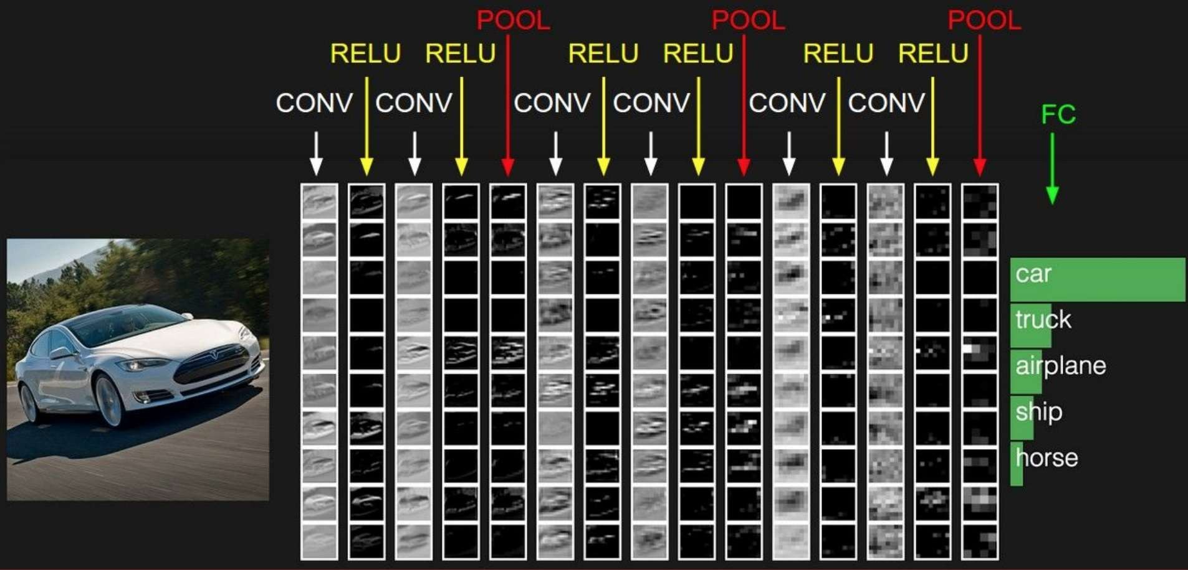
LAYERS IN CNN

Slide 94
A few important terms
Forward pass: Process of passing the data from input layer to output layer.
Cost Function: Difference between the predicted and true output of a NN.
Backpropagation: The process of updating parameters of a network depending on the cost function (using optimization algorithms viz., Gradient Descent, SGDM, ADAGrad, etc.) to minimize the cost.
Mini-batch: Number of images passing at once through the network.
Learning Rate: Speed by which the parameters are updated.
Iteration: A mini-batch performing a forward and a backward pass through
the network is an iteration.
Epoch: When the complete dataset undergoes a forward and a backward pass, an epoch is completed.

Slide 95
Visualize the graph on Tensorboard
tbCallBack = keras.callbacks.TensorBoard(log_dir='./Graph', histogram_freq=0,
write_graph=True, write_images=True)
model.fit(...inputs and parameters..., callbacks=[tbCallBack])
If you want to visualize the files created during training, run in your terminal
tensorboard --logdir path_to_current_dir/Graph

Slide 96
Use case: Image classification

Slide 97
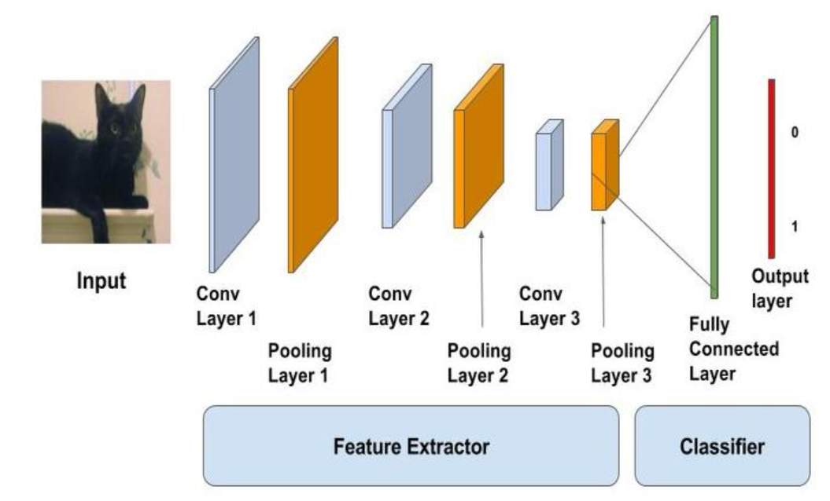
Image Classification on Cifar10

Slide 98
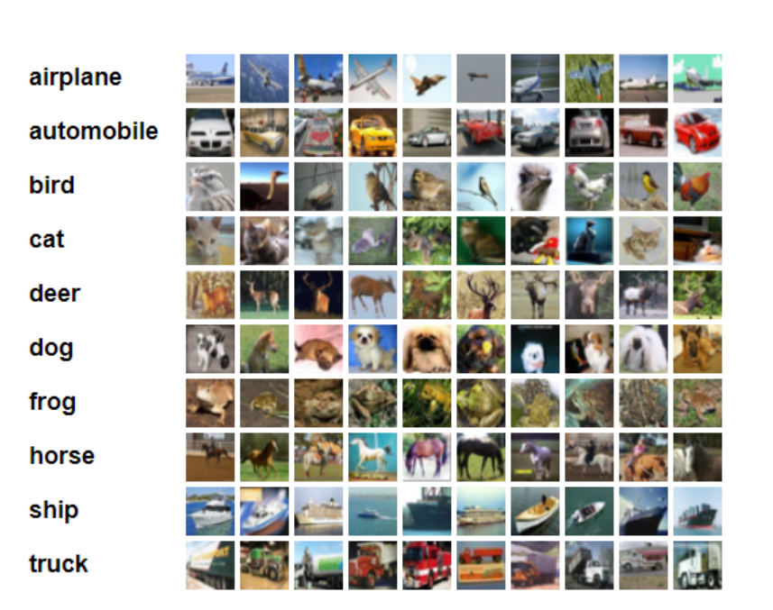
Data set: Cifar10
containing 60.000 different images
size of all images in this dataset is 32x32x3 (RGB)

Slide 99
Load data set
(x_train, y_train), (x_test, y_test) = cifar10.load_data() y_train = to_categorical(y_train, num_classes) y_test = to_categorical(y_test, num_classes)
X_train /= 255.0
X_test /= 255.0
Using one hot encoding to transform the output variable into a binary matrix
Normalizing the data

Slide 100
structure of the model
We will use a structure with two convolutional layers
followed by max pooling
and a flattening out of the network to fully connected layers to make predictions

Slide 101
Our baseline network structure can be summarized as follows:
Convolutional input layer, 32 feature maps with a size of 3×3, a rectifier activation function and a weight constraint of max norm set to 3.
Dropout set to 20%.
Convolutional layer, 32 feature maps with a size of 3×3, a rectifier activation function and a weight constraint of max norm set to 3.
Max Pool layer with size 2×2.
Flatten layer.
Fully connected layer with 512 units and a rectifier activation function.
Dropout set to 50%.
Fully connected output layer with 10 units and a softmax activation function

Slide 102
Convolutional layer
model = Sequential() model.add(Conv2D(32, (3, 3), padding='same', input_shape=x_train.shape[1:])) model.add(Activation('relu')) model.add(MaxPooling2D(pool_size=(2, 2))) model.add(Dropout(0.3))

Slide 103
Flatten layer
model.add(Flatten()) model.add(Dense(80)) model.add(Activation('relu')) model.add(Dropout(0.3)) model.add(Dense(num_classes)) model.add(Activation('softmax'))

Slide 104
Fitting model
model.compile(loss='categorical_crossentropy', optimizer=SGD, metrics=['accuracy']) model.fit(x_train, y_train, batch_size=batch_size, epochs=epochs, validation_split=0.2, shuffle=True) scores = model.evaluate(x_test, y_test, verbose=1) print('Test loss:', scores[0]) print('Test accuracy:', scores[1]) model.save('./model' + '.h5')

Slide 105
References
https://becominghuman.ai/back-propagation-in-convolutional-neural-networks-intuition-and-code-714ef1c38199
http://www.wildml.com/2015/12/implementing-a-cnn-for-text-classification-in-tensorflow/
https://towardsdatascience.com/a-walkthrough-of-convolutional-neural-network-7f474f91d7bd
http://cs231n.github.io/convolutional-networks/
https://www.youtube.com/watch?v=AgkfIQ4IGaM
https://adeshpande3.github.io/adeshpande3.github.io/A-Beginner's-Guide-To-Understanding-Convolutional-Neural-Networks/
https://www.youtube.com/watch?v=YRhxdVk_sIs
https://www.youtube.com/watch?v=FmpDIaiMIeA&t=748s
https://medium.com/@2017csm1006/forward-and-backpropagation-in-convolutional-neural-network-4dfa96d7b37e
https://brohrer.github.io/how_convolutional_neural_networks_work.html

